Slide 1
Project TITLE:
Hotel Booking Demand Forecasting & Cancellation Analysis Using Machine Learning
Project guide : dr.m.lavanaya
Student names: Roll numbers:
P.M.Manohar 22781A3397
P.Vishnu 22781A3399
T.Charitha reddy 22781A33D1
Guru mohan 22781A33E6
M.Vasanth kumar 23785A3312

Slide 2
Problem statment
Hotels struggle with unpredictable demand and cancellations.
Manual forecasting causes revenue loss and poor planning.

Slide 3
ABSTRACT:
This project develops a Machine Learning based system to predict hotel booking demand and cancellation risk.
It uses historical hotel booking data to train predictive models.
Two main functions are provided:
Forecasting monthly booking demand
Predicting the probability of booking cancellation
The trained models are deployed using a Streamlit web application, where users can enter booking details and get real-time results.
This system helps in better planning and decision making for hotel management.

Slide 4
Project Objectives
Forecast monthly demand
Predict room-wise bookings
Analyze cancellations
Study daily guest averages
Build Streamlit dashboard

Slide 5
Technology used
Python (Pandas, NumPy, Scikit-learn)
Matplotlib
Streamlit
SQLite3

Slide 6
Data Preprocessing
Handled missing values
Feature engineering
Encoding categorical data
Train-test split

Slide 7
Machine Learning Models Tested
Linear Regression
Decision Tree
Random Forest
XGBoost

Slide 8
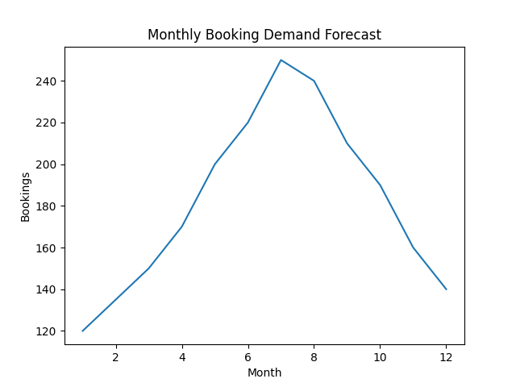
Monthly Booking Demand Forecast
Shows seasonal peaks in mid-year and lower demand at year-end.

Slide 9
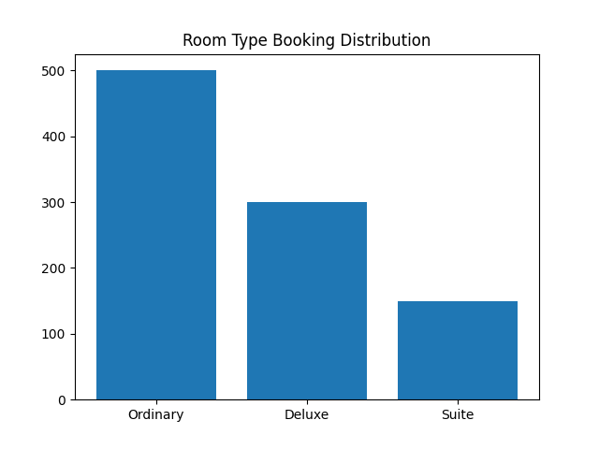
Room Type Booking Distribution
Ordinary rooms have highest demand, suites the least.
Ordinary rooms have highest demand, suites the least.

Slide 10
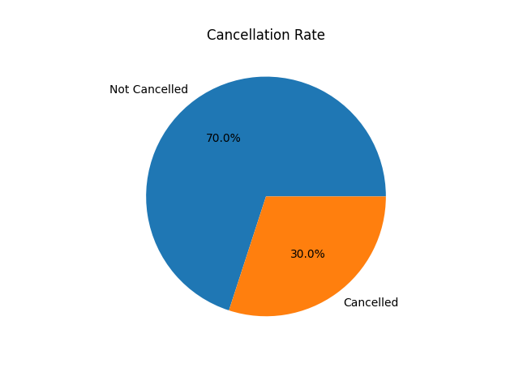
Cancellation Rate Analysis
Visualizes proportion of cancelled vs confirmed bookings.

Slide 11
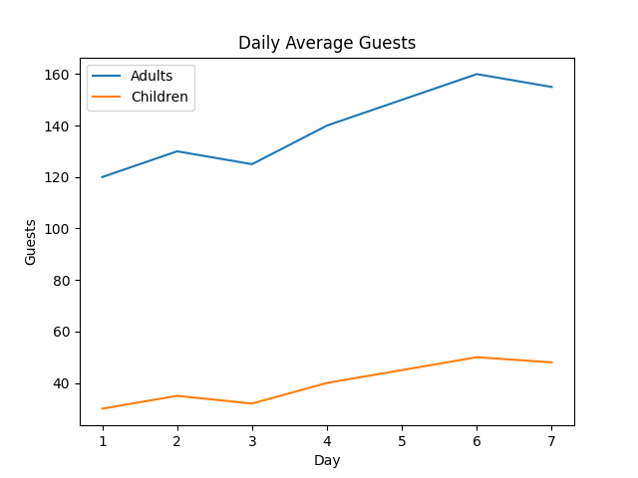
Daily Average Adults vs Children
Shows variation in number of adults and children across days.

Slide 12
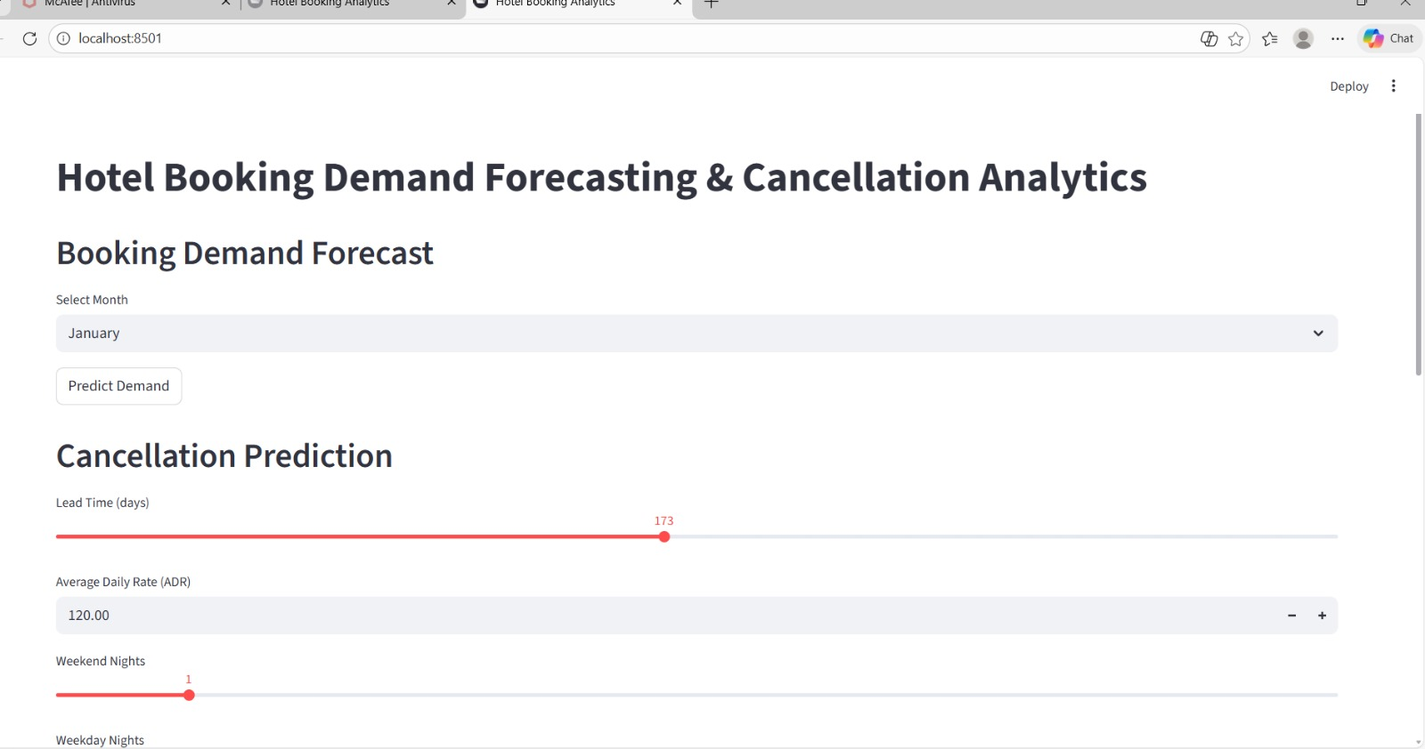
Sample output

Slide 13
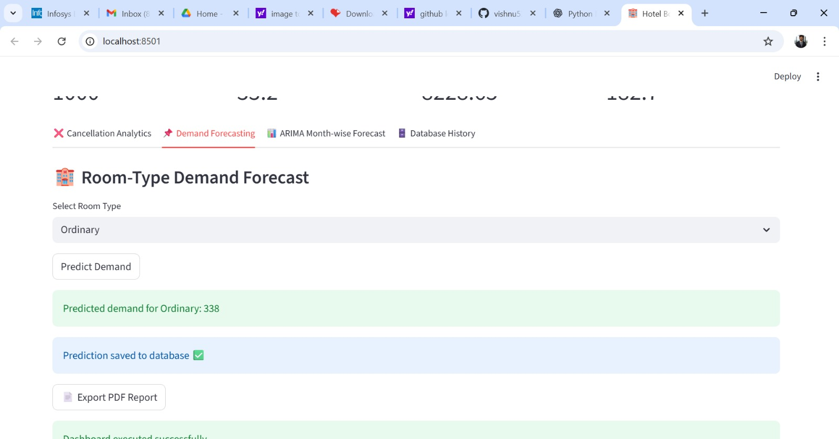

Slide 14
Result
The system successfully predicts monthly hotel booking demand.
It accurately identifies the cancellation risk for each booking.
Users can enter details through the Streamlit dashboard and get instant results
The dashboard is simple, fast, and user-friendly.
conclusion
This project shows the effective use of Machine Learning in hotel management.
It helps in better planning and reduces losses caused by cancellations.
Real-time predictions make the system practical for real-world use.

Slide 15
THANK YOU

